Slide 1
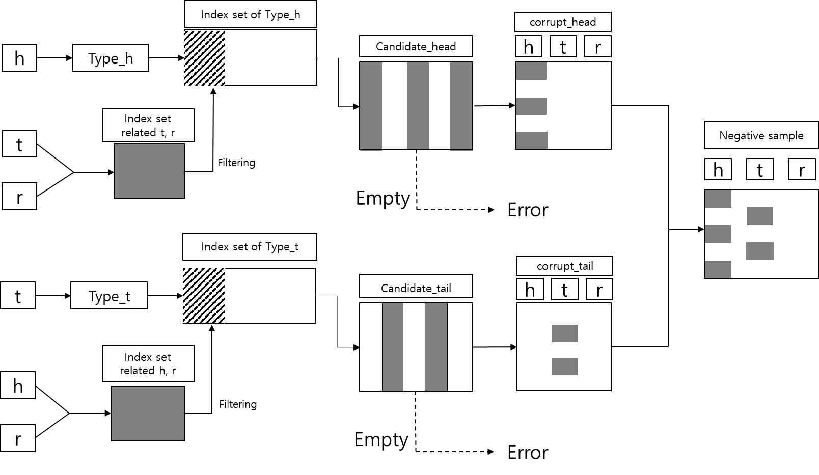

Slide 2

Index set of Type_h
h
Type_h
Corrupt_head
Candidate_head
h
t
r
Index set
related t, r
t
Filtering
Negative sample
r
h
t
r
Index set of Type_t
Empty
Error
t
Type_t
Corrupt_tail
Candidate_tail
h
t
r
Index set
related h, r
h
Filtering
r
Empty
Error

